Slide 1


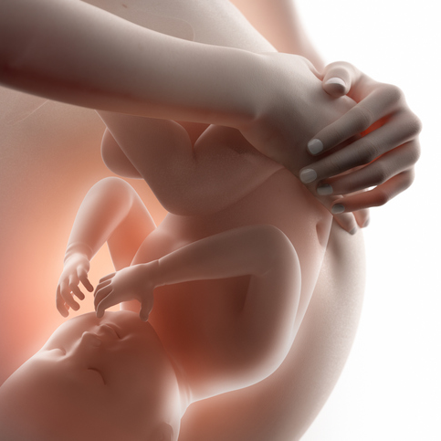

Care of Pregnant Patients in the ED
Sessions:
Monday, November 2nd, The Founders Room- Fishermen's Memorial Hospital 930h-1600h
Tuesday, November 3rd, The Boardroom- Main Floor- Digby General Hospital from 1130h-1600h
Learning Outcomes:
Identify and evaluate key sources of knowledge and resources available to health care providers,
including provincial guidelines, referral networks and emergency protocols.
Identify and explain the components of a comprehensive obstetrical assessment, including
maternal history and physical examination.
Demonstrate the management of imminent birth, following RCP’s unanticipated birth outside
the birthing unit for emergency obstetrical care.
Demonstrate the initial steps of neonatal resuscitation and immediate care of the newborn,
including vital sign monitoring, skin to skin care.
Discuss the initial assessment and care of a postpartum person including immediate postpartum complications.
Describe, differentiate and outline the initial management of the most common presenting
concerns during pregnancy:
  antenatal bleeding,
  threatened preterm labour,
  trauma, and
  hypertension – preeclampsia
  postpartum hemorrhage

